Slide 1
Javascript Closures
Understanding Scope, Lexical Environment & “The Backpack”

Slide 2
Learning Objectives
Understand scope (global vs local)
Learn lexical scoping
Define closures clearly
See real-world use cases
Avoid common pitfalls

Slide 3
Scope
JavaScript variables live in:
Global Scope
Accessible everywhere
Local Scope
Defined inside functions
Private to that function

Slide 4
Local Variables
function myFunction() {
let a = 4;
return a * a;
}
a is local
Only accessible inside the function
Acts like a private variable

Slide 5
Global Variables
let a = 4;
function myFunction() {
return a * a;
}
a is global
Accessible everywhere
Shared across scripts

Slide 6
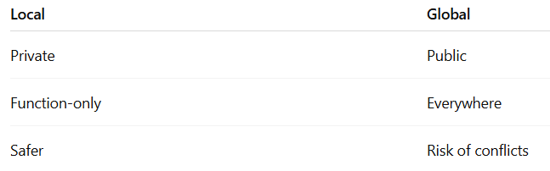
Key Differences

Slide 7
Dangerous Pattern
function myFunction() {
a = 4; // ❌ no let/const/var
}
Becomes global unintentionally
Common source of bugs

Slide 8
What is Lexical Scoping?
Scope determined by where code is written
Inner functions can access:
  Their own variables
  Parent variables
  Global variables

Slide 9
Lexical Scoping Example
function init() {
let name = "Mozilla";
function displayName() { // Inner function accesses outer variable
console.log(name);
}
displayName();
}

Slide 10
Closure Definition
A closure is:
“A function + its remembered environment”
Created when the function is defined
Not when it is executed

Slide 11
Basic Closure Example
function makeFunc() {
const name = "Mozilla";
function displayName() {
console.log(name);}
return displayName;
}
const myFunc = makeFunc();
myFunc(); // Still prints "Mozilla"
displayName keeps a reference to: name
Even after makeFunc() finishes
👉 This is a closure

Slide 12
Function Factory
// Creates customized functions
function makeAdder(x) {
return function (y) {
return x + y;
};
}

Slide 13
Function Factory Usage
// Each function has its own closure
const add5 = makeAdder(5);
const add10 = makeAdder(10);
add5(2); // 7
add10(2); // 12

Slide 14
Practical Use – UI Events
function makeSizer(size) {
return () => {
document.body.style.fontSize = `${size}px`;
};
}
Used in:
Event handlers
Callbacks
UI interactions

Slide 15
Closures for Privacy
const counter = (function () {
let privateCounter = 0;
return {
increment() { privateCounter++; },
value() { return privateCounter; }
};
})();
privateCounter is hidden
Only accessible via functions

Slide 16
Multiple Independant Closures
const counter1 = makeCounter();
const counter2 = makeCounter();
Each has its own state
No interference

Slide 17
Closure Scope Chain
const e = 10;
function sum(a) {
return b => c => d => a + b + c + d + e;
}
Closures can access:
Local scope
Parent scopes
Global scope

Slide 18
Common Pitfalls – (Loops + var)
for (var i = 0; i < 3; i++) {
setTimeout(() => console.log(i), 100);
}
❌ Output:
3
3
3

Slide 19
Fix with let
for (let i = 0; i < 3; i++) {
setTimeout(() => console.log(i), 100);
}
✅ Output:
0
1
2

Slide 20
Closure – Execution & Context
Each function call creates:
  New execution context
Normally destroyed after execution
👉 Closures preserve variables beyond this

Slide 21
Classic Closure Example
function createCounter() {
let counter = 0;
return function () {
counter++;
return counter;
};
}
const increment = createCounter();
// Execution
increment(); // 1
increment(); // 2
Increment(); // 3
// 👉 counter is remembered!

Slide 22
Why this works
Function carries:
Its code
Its closure (memory)
👉 State persists across calls

Slide 23
Real Insight
Without closures:
Local variables would be destroyed
With closures:
Variables live on

Slide 24
Performance Consideration
⚠️ Closures are powerful but:
Consume memory
Each function keeps its own scope
Avoid unnecessary nested functions

Slide 25
When to use closures
✅ Data privacy
✅ Function factories
✅ Event handlers
✅ State preservation

Slide 26
Mental Model Recap
Closure = 👉 Function + Backpack of variables

Slide 27
Final Takaway
Closures are not magic
They are a natural result of scope
Master them to unlock:
React patterns
Async logic
Functional programming

